Slide 1
Lecture 4
Divide & Conquer Approach
Recurrences
Instructor:- Mr. Fazl-e-Basit

Slide 2
Designing Algorithms
There are many ways to design algorithms.
In insertion sort we used an incremental approach: i.e. having sorted the sub list of
1…… j-1 , we insert a single element x, at its proper place which yields again the sorted sub list of 1……. j elements.
In the following section, we are going to study another approach of designing algorithms, known as Divide and Conquer approach.
Instructor:- Mr. Fazl-e-Basit

Slide 3
Divide and Conquer Approach
Divide-and-conquer is a technique for designing algorithms that consists of breaking the problem into several sub-problems that are similar to the original problem but smaller in size,
Solve the sub-problem recursively (successively and independently), and
Then combine these solutions to create a solution to the original problem.
Instructor:- Mr. Fazl-e-Basit

Slide 4
The divide and conquer paradigm involves three steps at each level of recursion.
Divide the problem into number of sub problems
Conquer the sub problems by solving them recursively. If the sub problem sizes are small enough then solve them in straight forward manner.
Combine the solutions to the sub problems into the solution for the original problem.
Instructor:- Mr. Fazl-e-Basit

Slide 5
Merge Sort
The Merge sort algorithm closely follows the divide and conquer paradigm. It works as follows.
Divide : Divide the n - element sequence to be sorted into sub sequences each of size n / 2 elements.
Conquer : Sort the two sub sequences recursively using merge sort.
Combine : Merge the two sorted sub sequences to produce another sorted list.
Instructor:- Mr. Fazl-e-Basit

Slide 6
The key operation of the merge sort algorithm is the merging of two sub sequences in the “combine” step.
To perform merging, we use Merge(A, left, mid, right); function, where A is an array of elements and left, right and mid representing leftmost, rightmost and center indices of an array respectively.
The above function assumes that the sub array A[left…..mid] and A[mid+1 …… right] are in sorted order where n = right - left + 1
Instructor:- Mr. Fazl-e-Basit

Slide 7
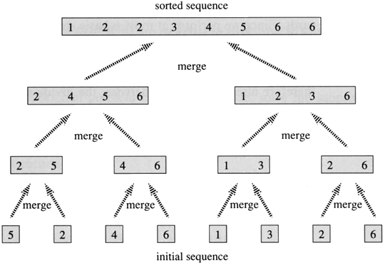
Instructor:- Mr. Fazl-e-Basit

Slide 8
Analyzing Divide and Conquer Algorithms
When an algorithm contains a recursive call to itself, its running time can often be described by a recurrence equation or recurrence, which describes the overall running time on a problem of size n in terms of running time on smaller inputs or Recurrence is an equation or an inequality that describes the function in terms of its value on smaller inputs.
We can use mathematical tools to solve the recurrence and provide bounds on the performance of the algorithm.
Instructor:- Mr. Fazl-e-Basit

Slide 9
A recurrence for the running time of a Divide-and-Conquer algorithm is based on three steps of basic paradigm.
Let T(n) is the running time of problem of size n. if the problem size is small enough , say n <= c for some constant c, the solution takes constant time, which we write as Θ(1).
Suppose our division of the sub problem yields a sub problems, each of size 1/b of the size of original. If we take D(n) time to divide the problem into sub problems and C(n) time to combine the solutions to sub problems into the solution to the original problem, we get the following recurrence.
Instructor:- Mr. Fazl-e-Basit

Slide 10
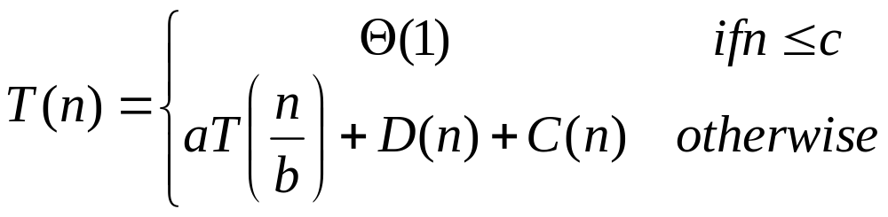
We will see later how to solve common recurrences of this form.
Instructor:- Mr. Fazl-e-Basit

Slide 11
Analysis of Merge Sort
Although the merge sort algorithm works fine when the number of elements are not even, for our simplicity we assume that the original problem size is a power of 2. later we will see that this assumption does not effect the order of growth of the solution to recurrence.
Merge sort on just one element takes constant time. When n > 1 , we break down the running time as follows.
Instructor:- Mr. Fazl-e-Basit

Slide 12
Divide : The Divide step just computes the middle of the sub array which takes constant time. Thus D(n) = Θ(1)
Conquer : We recursively solve two problems, each of size n/2 which contributes
T(n/2) + T(n/2) = 2T(n/2) to the running time
Combine : Merge procedure on n-elements takes Θ(n) time, how ????.
So C(n) = Θ(n)
Instructor:- Mr. Fazl-e-Basit

Slide 13
Analysis of Merge Sort
Statement Effort :- T(n)
MergeSort(A, left, right)
{
if (left < right) Θ(1)
{
mid = floor((left + right) / 2); Θ(1)
MergeSort(A, left, mid); T(n/2)
MergeSort(A, mid+1, right); T(n/2)
Merge(A, left, mid, right); Θ(n)
}
}
Instructor:- Mr. Fazl-e-Basit

Slide 14
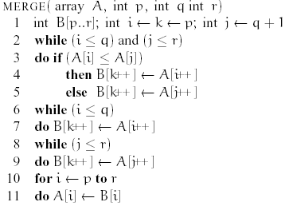
Analysis of Merge Sort
Instructor:- Mr. Fazl-e-Basit

Slide 15
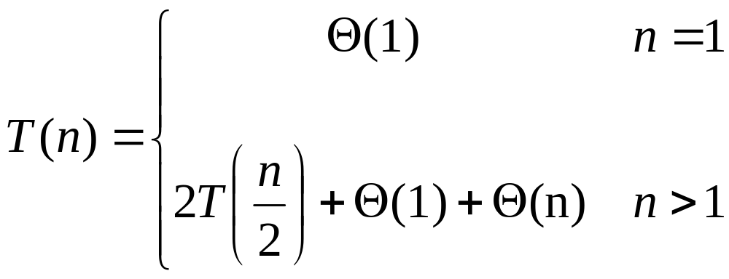
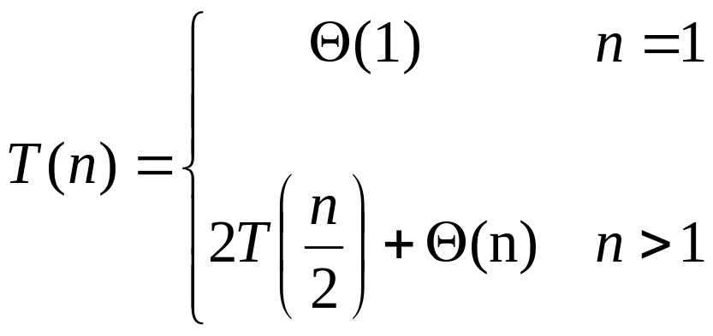
OR
We have D(n) + C(n) = Θ(1) + Θ(n). This sum is a linear function of n, i.e. Θ(n) . The worst case running time T(n) of merge sort:
Instructor:- Mr. Fazl-e-Basit

Slide 16
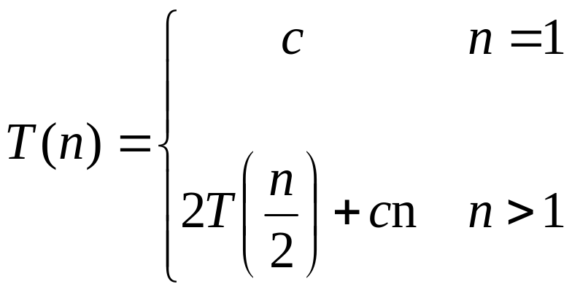
We shall see in “Master Theorem” ( to be discussed later) that T(n) for Merge Sort is Θ(n.lgn) [ lgn means log₂n ].
Even we can predict and prove this time without using master theorem. Lets rewrite the above recurrence.
Where c represents the time required to solve the problem of size 1.
Instructor:- Mr. Fazl-e-Basit

Slide 17
Construction of recurrence tree for the recurrence T(n) = 2T(n/2) + cn
cn
cn
c.n/2
c.n/2
cn
c.n/4
c.n/4
c.n/4
c.n/4
cn
c
c
c
c
c
c
c
c
cn
Instructor:- Mr. Fazl-e-Basit

Slide 18
Now we add the costs of each level:
  Top level : cn
  Next level from top: c.n/2 + c.n/2 = cn
  Next level : c.n/4 + c.n/4 + c.n/4 + c.n/4 = cn
In general each level i (starting from 0) has 2^{i} nodes and each node contributing the cost c(n/2^{i}).
So that the total cost the ith level has the total cost 2^{i}c(n/2^{i}) = cn
At the bottom level, there are n nodes each contributing a cost of c, for total cost of cn.
Instructor:- Mr. Fazl-e-Basit

Slide 19
The total number of levels of above recursion tree are lgn + 1.
So to compute total cost represented by the recurrence, we simply add up all costs of all levels. There are lgn + 1 levels and each is costing cn, for total cost of
cn(lgn + 1) = cnlgn + cn
ignoring lower order terms and the constant c we get the desired result of Θ(n.lgn) .
Instructor:- Mr. Fazl-e-Basit

Slide 20

The worst case running time T(n) of merge sort could be described by the recurrence:
Whose solution was claimed to be T(n) = Θ (n.lg n)
We will study three methods of solving recurrences I.e to obtain the asymptotic O or Θ bounds on the solution.
Instructor:- Mr. Fazl-e-Basit

Slide 21



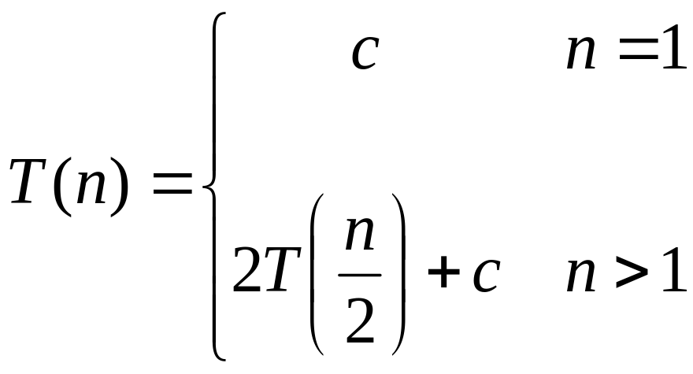
Recurrence Examples
Instructor:- Mr. Fazl-e-Basit

Slide 22
Methods for Solving Recurrences
Substitution method
Recursion Tree (iteration) method
Master method
Instructor:- Mr. Fazl-e-Basit

Slide 23
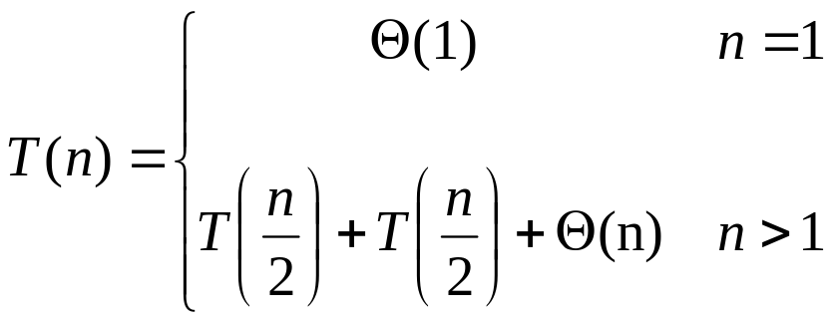
The recurrence describing the worst case running time of Merge Sort is really :
the recurrence that arise from the running time of an algorithm generally have T(n) = Θ (1), for sufficiently small n. consequently we generally omit the statements of the boundary conditions of recurrences and assume that T(n) is constant for small n.
When we state and solve recurrences, we often omit floors, ceilings and boundary conditions. We move ahead and later see whether or not they matter. They usually don’t but it is important to know when they do so.
Instructor:- Mr. Fazl-e-Basit

Slide 24
Substitution Method
The substitution method entails two steps
  Guess the form of the solution
  Use mathematical induction to find the constants and show that the solution works.
This method is powerful but is obviously applied only in cases when it is easy to guess the form of the answer.
The substitution method can be used to establish either upper or lower bounds on the recurrence.
Instructor:- Mr. Fazl-e-Basit

Slide 25
As an example, lets determine an upper bound on the recurrence
T(n) = 2T(n/2) + n
We guess that the solution is T(n) = O(n.lg n). It means that we have to prove that T(n) ≤ cn. lg n for an appropriate choice of the constant c > 0.
Similarly from above we can say that
T(n/2) ≤ c.n/2. lg n/2.
Instructor:- Mr. Fazl-e-Basit

Slide 26
We have
T(n) = 2T(n/2) + n
≤ 2.c.n/2. lg n/2 + n
= c.n. lg n/2 + n
= c.nlg n - c.nlg₂2 + n
= c.nlg n - c.n + n
ignoring small terms from above
≤ c.nlg n
Where the last step holds as long as c ≥ 1.
So from above it is proved that T(n) = O(n. lg n ).
Instructor:- Mr. Fazl-e-Basit

Slide 27
Making a good guess
Unfortunately there is no general way to have a good guess. Guessing a solution needs experience and occasionally creativity.
We can use recursion trees for generating good guess, which we saw while analyzing Merge Sort.
Another way to to make good guess is prove for loose upper and lower bounds on the recurrence and the reduce the range of uncertainty. We can gradually lower the upper bound and raise the lower bound until we converge on the correct, asymptotically correct solution
Instructor:- Mr. Fazl-e-Basit

Slide 28
Avoiding Pitfalls
We can misinterpret the asymptotic notation if we say that our guess for T(n) = 2T(n/2) + n is O(n). I.e. T(n) ≤ cn and then arguing that
T(n) = 2T(n/2) + n
≤ 2.c.n/2 + n
= cn + n or n.(c + 1)
= O( n ) Wrong !!!
The error is that we haven't proved the exact form of our hypothesis I.e. T(n) ≤ cn
Instructor:- Mr. Fazl-e-Basit

Slide 29
Recursion Tree Method
As we found that it is sometime difficult to have a good guess in case of substitution method.
Drawing out the recursion tree as we did in the analysis of Merge Sort is the straightforward way to have a good guess.
In this method each node represents the cost of each sub problem somewhere in the set of recursive function invocations. We sum all the costs of sub problems at all levels of recursion to find the logical guess for our solution.
Instructor:- Mr. Fazl-e-Basit

Slide 30
This method is more useful for describing the running time of divide and conquer problems.
This method is used to generate a very good guess which can be later verified by the substitution method. However you can use a recursion tree method as a direct proof of a solution to the recurrence.
Instructor:- Mr. Fazl-e-Basit

Slide 31
Master’s Theorem
The Master Method provides the bound for the recurrence of the form
T(n) = aT(n/b) + f(n)
where a >= 1, b > 1 and f(n) is a given function.
The above recurrence describes the running time of an algorithm that divides the problem of size n into a sub problems, each of size n/b, where a and b are positive constants.
Instructor:- Mr. Fazl-e-Basit

Slide 32
Then a sub problems are solved recursively, each in time T(n/b).
The cost of dividing problem and combining the results of the sub problems is described by the function f(n) i.e.
f(n) = D(n) + C(n)
This method requires the memorization of three cases as follows
Instructor:- Mr. Fazl-e-Basit

Slide 33
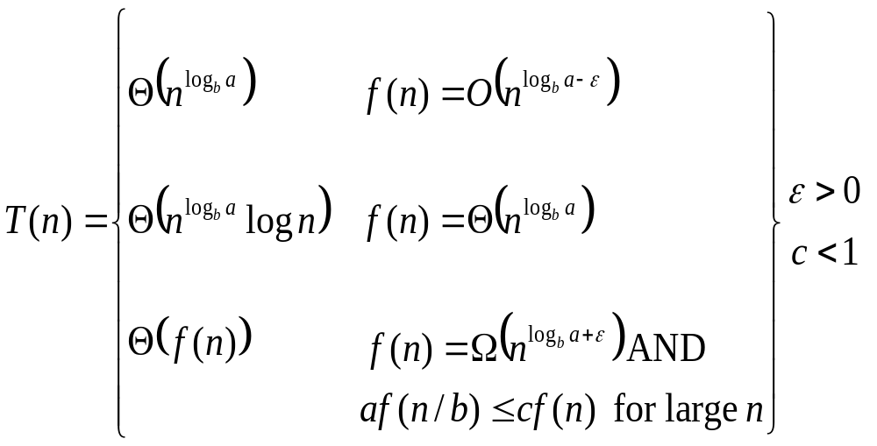
The Master Theorem
if T(n) = aT(n/b) + f(n) then

Slide 34
You can go through Book (second edition) page no 73 for clear understanding of previous three cases.
Instructor:- Mr. Fazl-e-Basit

Slide 35
Master Method -- Examples
Let T(n) = 9T(n/3) + n
  a=9, b=3, f(n) = n
  Now n^{logb a} = n^{log3 9} = n² = Θ(n²)
  So we need to subtract power from 2, so that it seems to be like f(n) which is = n
  So let ε=1 and
  f(n) = O(n^{log3 9 - ε}), where ε=1, case 1 applies: i.e.
  f(n) = O(n²⁻¹)
  Thus the solution is T(n) = Θ(n²)
Instructor:- Mr. Fazl-e-Basit

Slide 36
Example 2:
Let T(n) = T(2n/3) + 1
  a=1, b=3/2, f(n) = 1
  Now n^{log}_{b} ª = n^{log}_{3/2} ¹ = n⁰ = 1
  So we can apply case 2:
  i.e if f(n) = Θ(n^{log}_{3/2} ¹) = Θ(1),
  Thus the solution is T(n) = Θ(^{log}₂^{n})
Instructor:- Mr. Fazl-e-Basit

Slide 37
Example 3
Let T(n) = 3T(n/4) + n.log n
  a=3, b=4, f(n) = n.log n
  Now n^{logb a} = n^{log}₄ ³ = n^{0.8}
  So we need to add some factor with power (0.8), so that it seems to be like f(n) which is = n.log n , which corresponds to third case of our theorem.
  So let ε=0.2 and we have n^{0.8+0.2} = n¹ ( near to f(n) )
  Now we have to fulfill the second part of this case i.e.
  af(n/b) ≤ c.f(n) for c < 1
  3f(n/4) ≤ c. n. log n
  3. n/4. log (n/4) ≤ c. n. log n let c = ¾ < 1
  3/4. n. log (n/4) ≤ 3/4. n. log n
  Above inequality is proved so we have T(n) = Θ(n.logn)
Instructor:- Mr. Fazl-e-Basit

Slide 38
Assignment # 2
Use the Master method to give tight asymptotic bounds for the following recurrences
T(n) = 4T(n/2) + n
T(n) = 4T(n/2) + n²
T(n) = 4T(n/2) + n³
T(n) = 2T(n/4) + n^{1/2}
Due Next Week, same day, same time
Instructor:- Mr. Fazl-e-Basit

